Slide 1
Restaurant Rating Analysis & Prediction
Using Machine Learning
Presented by: [Vishwaraj Khatpe]
Date: April 2025

Slide 2
Introduction
Objective: Analyze Pune restaurant data to uncover trends
Techniques used: EDA, Linear Regression, KMeans Clustering
Goals: Predict dining ratings & discover location-based pricing patterns

Slide 3
Dataset Overview
Source: Zomato Pune dataset
~4900 rows, 17 columns
Key columns: Restaurant_Name, Category, Pricing_for_2, Dining_Rating, Is_Chain, Location

Slide 4
Data Preprocessing
Removed duplicates and handled missing values
Converted 'Is_Chain' to binary labels
Scaled numeric and encoded categorical variables

Slide 5
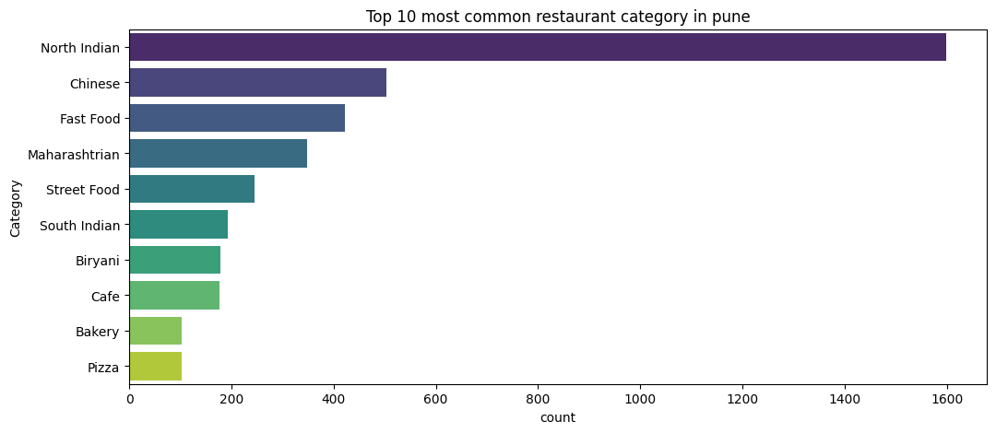
EDA 1 – Most Common Restaurant Categories
Bar chart of top 10 Primary_Category
Most popular: North Indian, Chinese, fast food

Slide 6
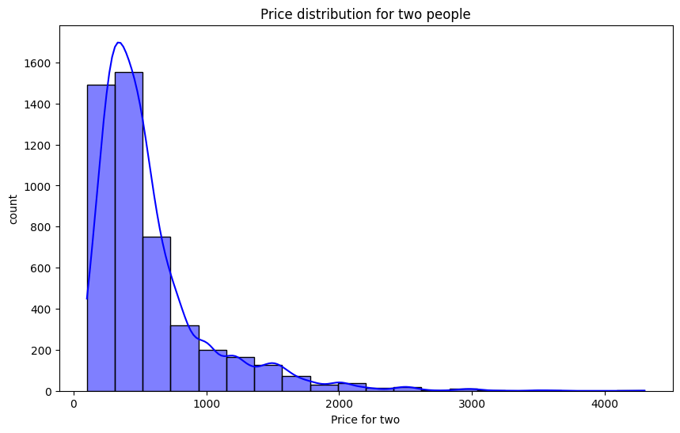
EDA 2 – Price Distribution
Histogram of Pricing_for_2
Most restaurants priced between ₹200 and ₹800

Slide 7
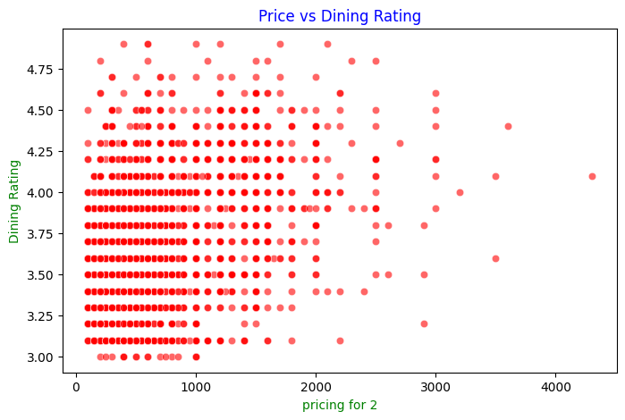
EDA 3 – Correlation Between Price and Rating
Scatter plot: Pricing_for_2 vs Dining_Rating
No strong correlation; some budget places highly rated

Slide 8
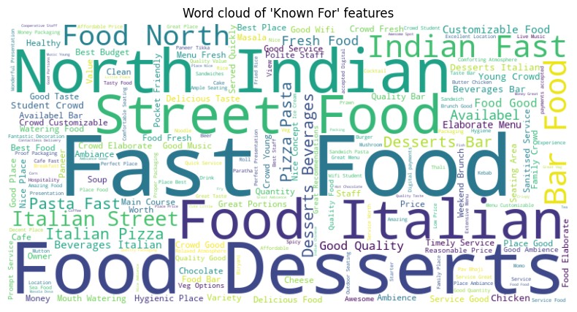
EDA 4 – Word Cloud for 'Known For'
Word cloud from Known_for1 column
Popular themes: Fast food, Desserts, italian

Slide 9
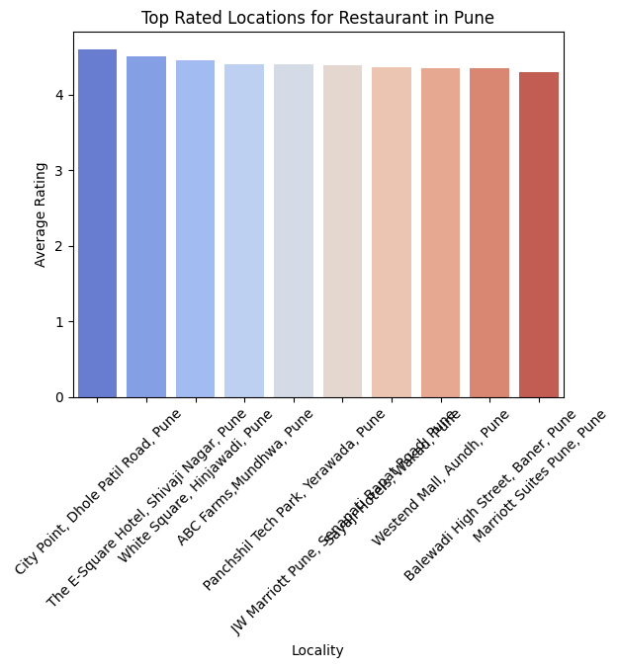
EDA 5 – Best Locations for Restaurants
Top-rated areas: Koregaon Park, Viman Nagar, Kothrud
Location-based rating insights

Slide 10
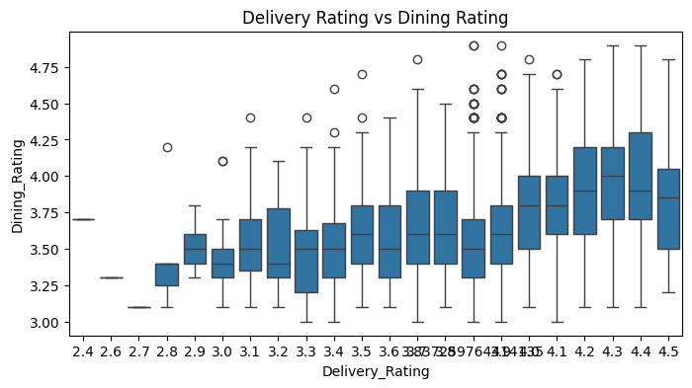
EDA 6 – Delivery Rating vs Dining Rating
Box plot comparison
Delivery and dining experience rating trends

Slide 11
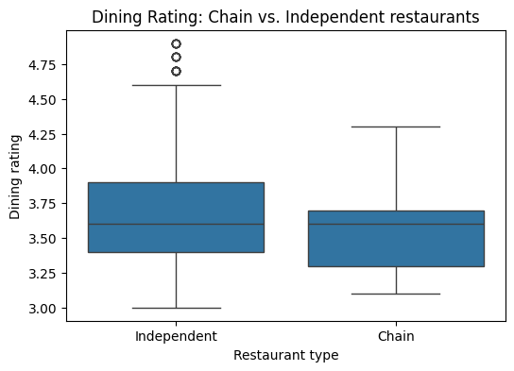
EDA 7 – Chain vs Independent Restaurants
Boxplot analysis for pricing and rating
Independent restaurants show wider variation

Slide 12
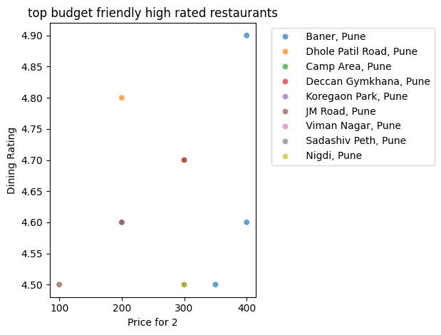
EDA 8 – Best Budget-Friendly Restaurants
Filtered: Rating ≥ 4.4 & Price ≤ ₹600
Great value-for-money restaurants across key localities

Slide 13
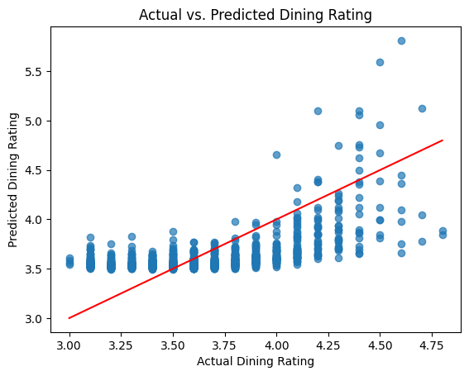
Linear Regression – Predicting Dining Rating
Features: Pricing_for_2, Votes, Delivery_Rating
Target: Dining_Rating
Model: Linear Regression with train-test split
Output: Scatter plot (Actual vs Predicted), R² score, MSE

Slide 14
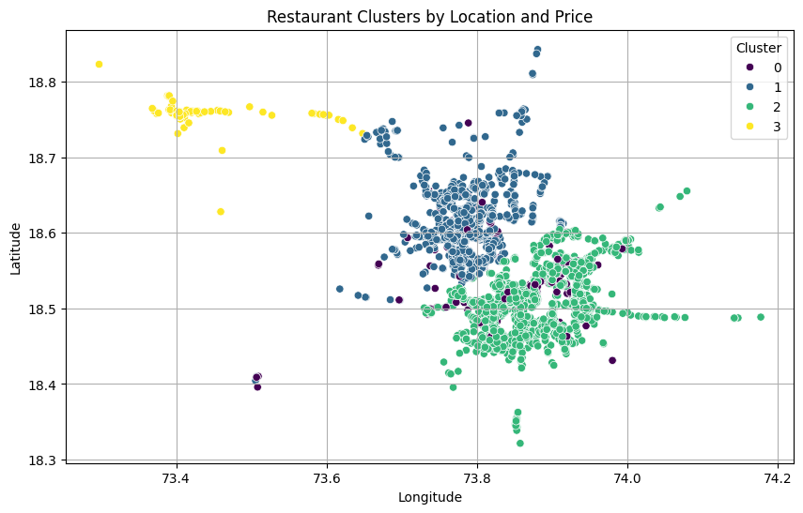
KMeans Clustering – Location & Pricing
Features: Latitude, Longitude, Pricing_for_2
Used Elbow Method to determine optimal K
Identified clusters of budget, mid-range, and premium restaurants

Slide 15
Key Takeaways
High-rated restaurants don't need to be expensive
Chain status doesn't guarantee better ratings
KMeans revealed location-based pricing zones

Slide 16
Conclusion
Combined EDA with ML to gain business insights
Regression predicted customer satisfaction trends
Clustering supported geo-targeted strategy

Slide 17
Thank You / Q&A
Thank you for your attention!
Questions?

